Slide 1
Chronic kidney disease
Emad abokhabar
Lecturer of Internal medicine and nephrology
Sohag university

Slide 2
Definition
CKD is defined by the presence of kidney damage or decreased kidney function for three or more months, irrespective of the cause.

Slide 3
Definition

Slide 4
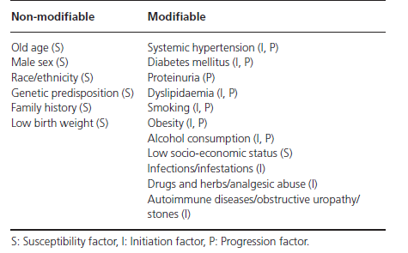
Risk factors for CKD

Slide 5
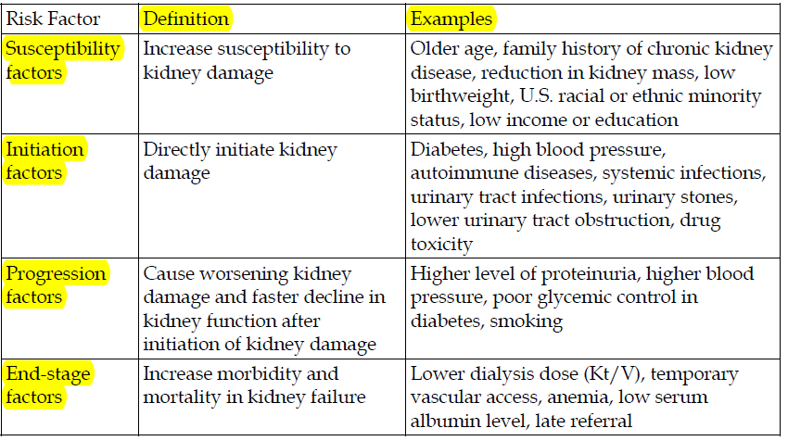
Risk factors for CKD

Slide 6
CAUSES

Slide 8
STAGES

Slide 9
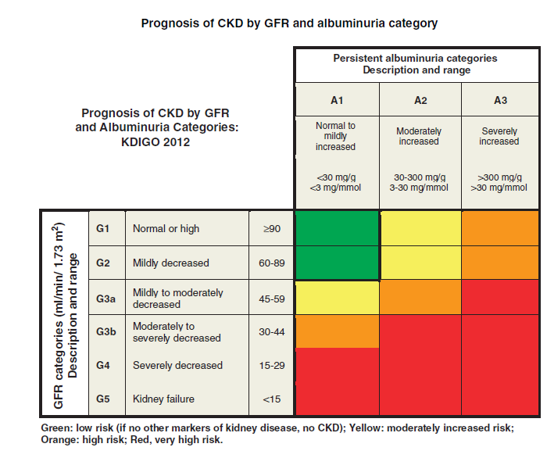
Classifications

Slide 10
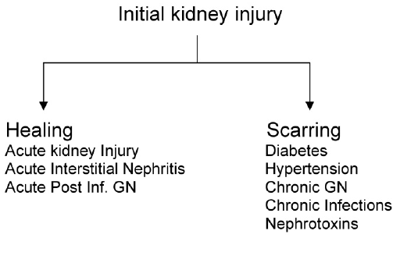
Progression of initial kidney injury

Slide 11
CKD MANIFESTATIONS

Slide 12
Evaluation of CKD

Slide 13
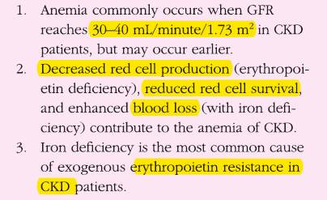
Anemia of CKD

Slide 14
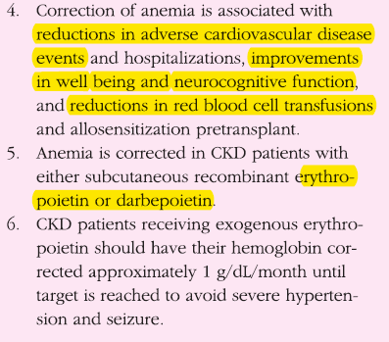
Anemia of CKD

Slide 15
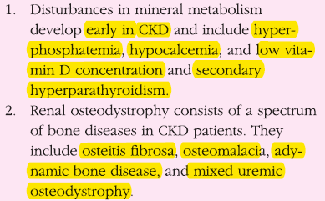
Metabolic Mineral Disturbances associated with CKD

Slide 16
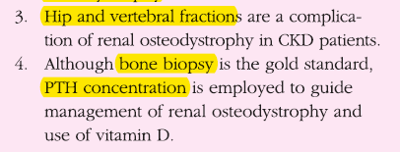
Metabolic Mineral Disturbances associated with CKD

Slide 17
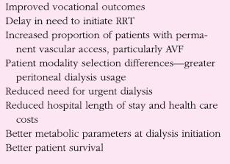
Benefits of early referral

Slide 18
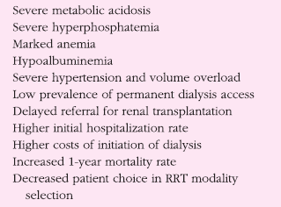
Consequence of Late Referral

Slide 19
What can primary care providers do?
Recognize and test at-risk patients
Educate patients about CKD and treatment
Focus on good glycemic control in people with diabetes
For those with CKD:
Blood pressure below 130/80
Use an ACE inhibitor or ARB
More than one drug is usually required
A diuretic should be part of the regimen

Slide 20
What can primary care providers do?
Monitor eGFR and UACR
Treat cardiovascular risk, especially with smokers and hypercholesterolemia
Screen for anemia (Hgb), malnutrition (albumin), metabolic bone disease (Ca, Phos, PTH)
Refer to dietitian for nutritional guidance
Consult or team with a nephrologist

Slide 21
IMPORTANT NOTS
Use GFR, Urine Microalbumin to diagnose CKD
If GFR < 60 or Microalbumin/creat > 30 start ACE (If cough on ACE, start ARB)
Avoid NSAIDS
Refer to Nephrology for GFR < 30
Refer for Transplant evaluation for GFR < 20
Promote smoking cessation
Keep BP < 140/90
Keep HbA1C < 7.0
Keep LDL < 100

Slide 22
Management

Slide 23
Management

Slide 24
Management

Slide 25
Management

Slide 26
Management

Slide 27
Complications

Slide 28
Complications

Slide 29
RENAL REPLACMENT THERAPY

Slide 30
Types of Dialysis
Peritoneal Dialysis:
Uses the peritoneal membrane as the filter. The membrane covers the abdominal organs and lines the abdominal wall. This takes place inside the body and requires placement of a catheter in the peritoneal cavity to allow fluid to be instilled and drained out.
Hemodialysis:
Uses a dialyzer or artificial kidney to filter the blood. This takes place outside the body and requires some form of access to the circulatory system. Accomplished with the use of a sophisticated computerized control unit (dialysis machine ☺)

Slide 31
Other choices
kidney transplantation:
To be placed on a transplant list the patient must be on some form of renal replacement therapy, whether it is peritoneal dialysis or hemodialysis
Once a patient is accepted for transplant, the date of start of dialysis is the date they are active on the list
If the patient has a living donor who has been accepted as healthy donor, it is possible to have a pre-emptive transplant, bypassing dialysis.
No treatment or palliative care

Slide 32
HEMODIALYSIS

Slide 33
Access Location
Internal Jugular Vein
Primary site of choice due to lower associated risk of complication and simplicity of catheter insertion.
Femoral Vein
Patient immobilized, the femoral vein is optimal and constitutes the easiest site for insertion.
Subclavin Vein
The least preferred site given its higher risk of pneumo/hemothorax and its association with central venous stenosis.

Slide 34
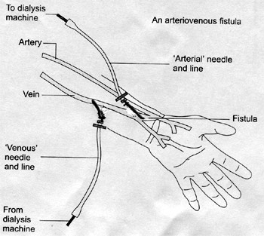
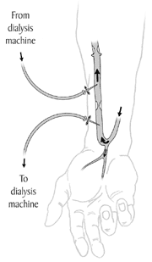
AV fistula

Slide 35
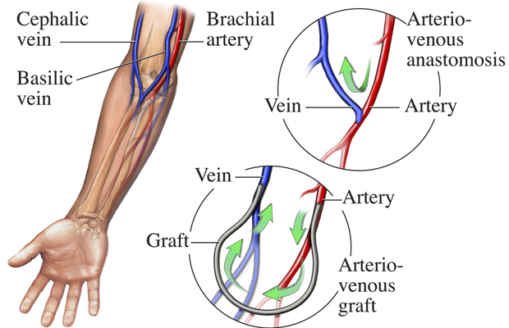
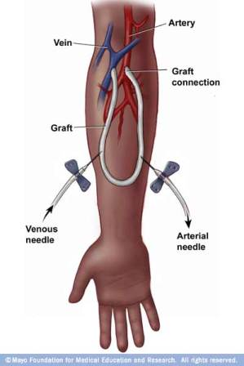
AV Graft

Slide 36
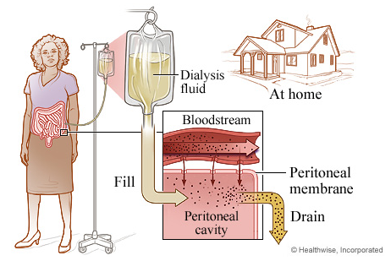
Peritoneal dialysis
advantage
simple, cost effective.
major disadvantages of PD are –
poor solute clearance,
poor uremic control,
risk of peritoneal infection
mechanical obstruction of pulmonary & cardiovascular performance.

Slide 37
How PD Works
In PD, catheter used to fill abdomen with dialysis solution.
peritoneum allows waste products & extra fluid to pass from blood into dialysis solution.
usually contains dextrose that will pull wastes & extra fluid into abdominal cavity.
used solution, containing wastes and extra fluid thrown away.
process of draining and filling is called an exchange, takes about 30- 40 minutes.
period the dialysis solution is in abdomen - dwell time.
typical schedule calls for 4 exchanges/day, each with dwell time of 4- 6 hrs.

Slide 38
THANK YOU

